Slide 1
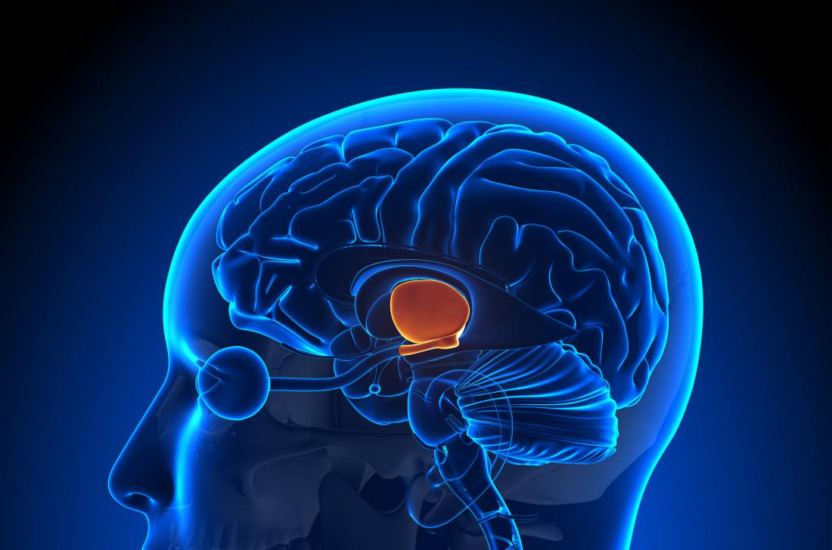

Year 12 Human Biology The Endocrine System Part 2

Slide 3
Students will be able to:

Slide 4
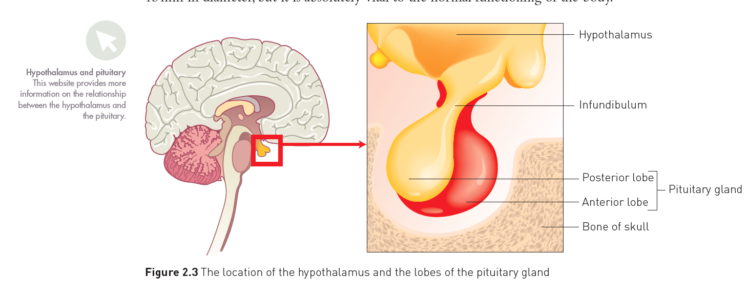


Hypothalamus
The hypothalamus and pituitary gland work together to control the functioning of many of the other glands, For this reason, the pituitary gland is often called the master gland. Combined, they can be thought of as the command centre for the body.
Notes:
Teacher Cue – refer to the vocabulary box as you read through and “unpack” the definition provided. Use hand gestures to emphasise the ”2 or more”, “mixed” and “separated” parts of the definition.
Have students complete CFU 1 as a pair-share, then record these definitions & examples as notes (with diagrams) if desired.
CFU 2 – pair-share, then whiteboards for answers – call on non-volunteers.

Slide 5
Hypothalamus
The hypothalamus has roles in both the nervous and endocrine systems and serves as a connection between the two systems. It regulates many of the basic functions of the body, such as body temperature, water balance and heart rate, in addition to increasing or decreasing the secretions of other glands
The hypothalamus is located at the base of the brain, below the thalamus and above the pituitary gland. It is about the size of an almond.
Notes:
CFU – read through the slide, have students look closely at the diagram, then allow think time, before asking them to explain it to their partner using the key terms pure substance and mixture. Call on non-volunteers and provide feedback, encouraging detailed responses in full sentence form.

Slide 6
Hypothalamus
Many of the functions of the hypothalamus are carried out through the pituitary gland.
The hypothalamus secretes releasing factors, which stimulate the secretion of a hormone, or inhibiting factors, which slow down the secretion of a hormone. These factors travel through blood vessels to the anterior lobe of the pituitary gland, affecting the secretion of its hormones.
Other hormones are produced by the hypothalamus and pass along the nerve fibres to the posterior lobe of the pituitary gland where they are then released.

Slide 7
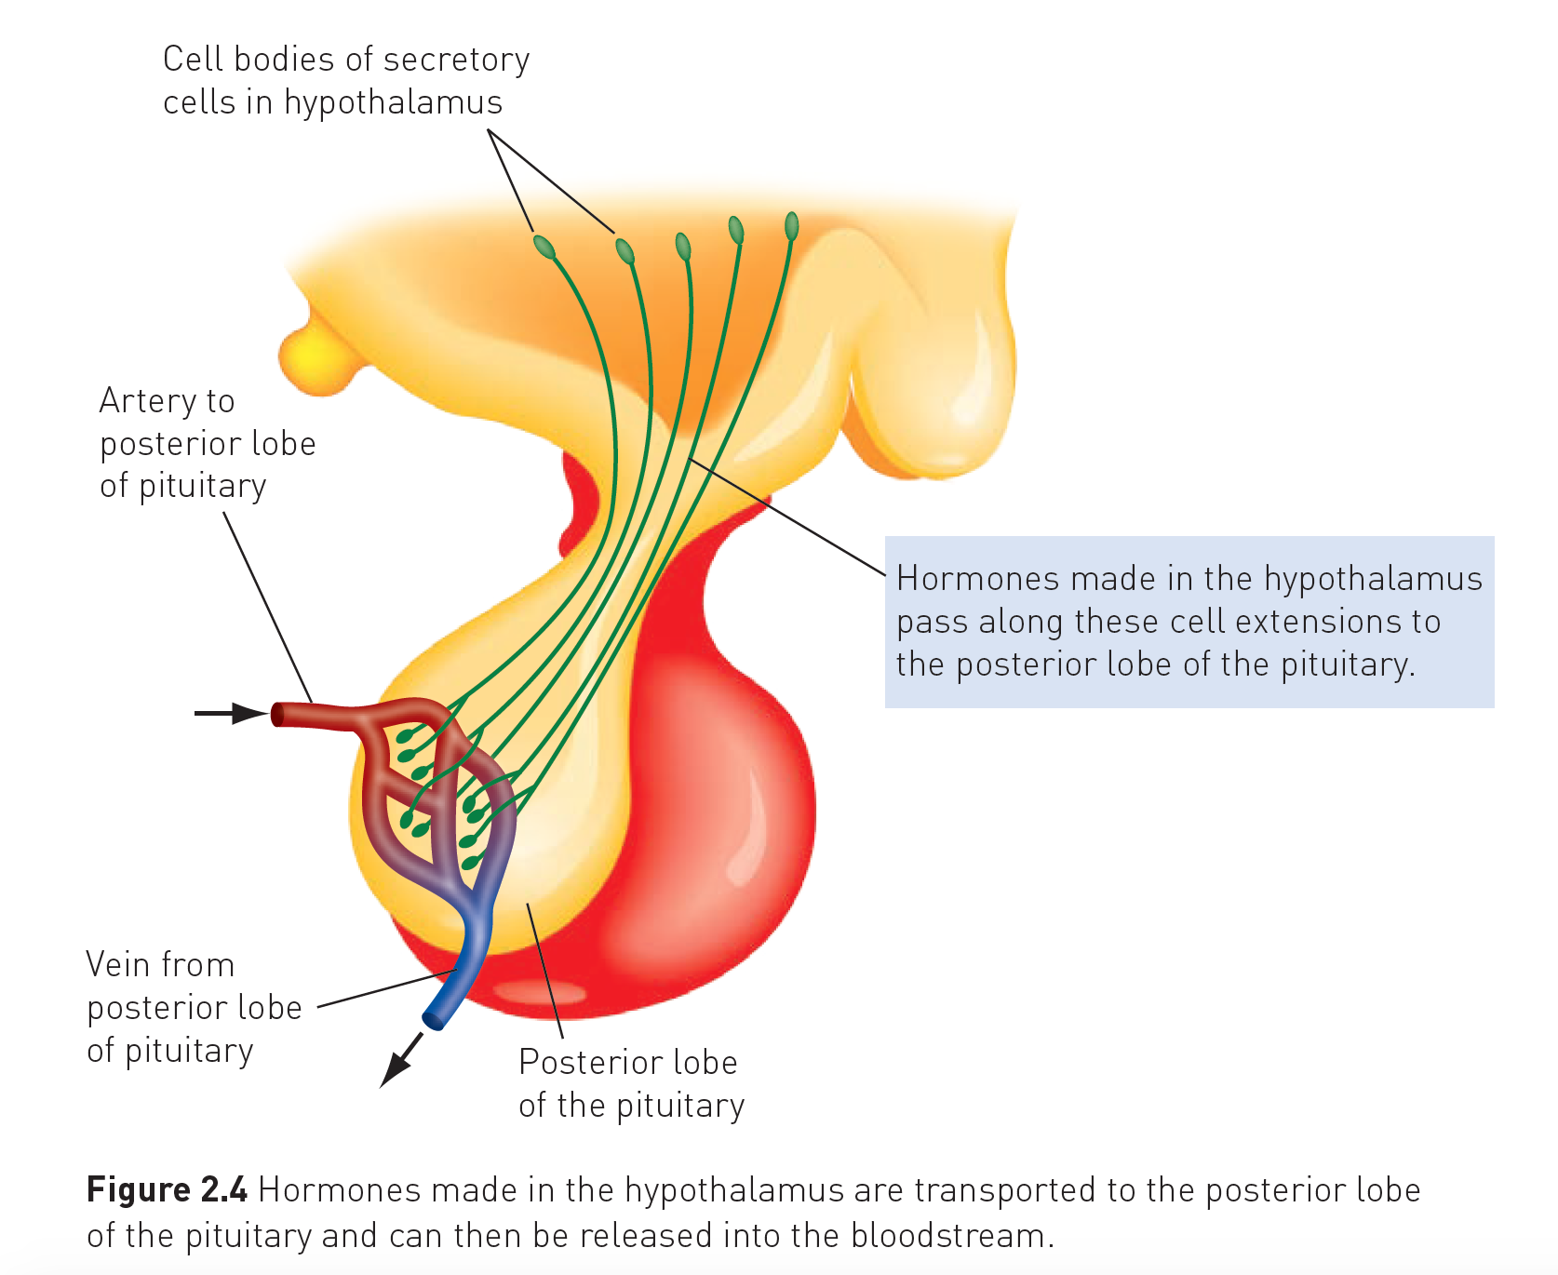
Pituitary Gland
The pituitary gland, or hypophysis, lies just under the hypothalamus and is joined to the hypothalamus by a stalk called the infundibulum.
It is not much bigger than a large pea, about 13mm in diameter, but it is absolutely vital to the normal functioning of the body.

Slide 8
Pituitary Gland
The pituitary gland consists of an anterior lobe and a posterior lobe, each of which functions separately.
The anterior (front) lobe has no nerves connecting it to the hypothalamus, rather, they are connected by a complex network of blood vessels lying in the infundibulum.
The posterior (rear) lobe is joined to the hypothalamus by nerve fibres that come from nerve cell bodies in the hypothalamus and pass through the infundibulum to the posterior lobe.
It is not a true endocrine gland because it does not secrete substances. Instead, it simply stores and releases hormones.

Slide 9
Anterior lobe of the pituitary gland
The anterior lobe of the pituitary gland (the adenohypophysis) releases a number of hormones that. regulate a great range of bodily activities.
Secretions of the anterior lobe are in turn controlled by releasing and inhibiting factors secreted by the hypothalamus.

Slide 10
Anterior Lobe of the Pituitary gland
The following hormones are released by the anterior lobe of the pituitary gland:
Gonadotropins are hormones that affect the gonads, the ovaries and testes. Follicle-stimulating hormone (FSH) stimulates development of the follicles that contain eggs in the ovary of the female. In the male, FSH stimulates the production and maturation of sperm in the testes. Luteinising hormone (LH) works with FSH in the female to bring about ovulation and to form a structure called the corpus luteum after ovulation. In the male, LH stimulates interstitial cells in the testes to secrete male sex hormones.
Growth hormone (GH), or somatotropin, stimulates body growth, particularly growth of the skeleton. It increases the rate at which amino acids are taken up by cells and built into proteins. GH is secreted throughout life as it helps to maintain the size of organs once maturity is reached.
Thyroid-stimulating hormone (TSH), or thyrotropin. stimulates production and release of . hormones from the thyroid gland.
Adrenocorticotropic hormone (ACTH), or adrenocorticotropin, controls production and release of some of the hormones from the cortex of the adrenal glands.
Prolactin (PRL), or lactogenic hormone, works with other hormones to initiate and maintain milk production in females.

Slide 11
Posterior Lobe of the Pituitary Gland
The posterior lobe of the pituitary gland (the neurohypophysis) releases the hormones oxytocin and antidiuretic hormone, but neither is manufactured in the posterior lobe.
Both hormones are produced in special nerve cells in the hypothalamus of the brain. These cells have long extensions that pass through the infundibulum to the posterior lobe Hormones manufactured in the cells move down the extensions and are stored ready for release into the bloodstream.
The release of the hormones is triggered by nerve impulses initiated in the hypothalamus and conducted along the cell extensions.

Slide 12
Posterior lobe of the Pituitary Gland
Oxytocin (OT) stimulates contraction of the muscles of the uterus. It is released in large quantities during labour. Oxytocin also stimulates contraction of cells in the mammary glands, resulting in release of milk during breastfeeding.
Antidiuretic hormone (ADH), or vasopressin, causes the kidneys to remove water from urine that is forming. This water is returned to the bloodstream. In this way. ADH helps to retain fluid within the body. At higher concentrations, ADH can also cause constriction of small arteries, the arterioles. This is why its alternative name is vasopressin.

Slide 13
